Slide 1
CYBR 520
Module 8: Machine Learning Special Topic/ Deep Learning using AutoKeras

Slide 2
Please refer to Module 8 on github to obtain the codes or refer to the book’s github repo

Slide 3
Topics
Intro. To Deep Learning
Deep Learning Vs. Classical ML
Introduction to AutoKeras
Why AutoKeras?
Installation
Basic Functionalities
Image Classification Example
Text Classification Example
Hyperparameter Tuning
Advantages and Limitations
Conclusion

Slide 4
Introduction to Deep Learning
Deep learning is a subfield of machine learning that focuses on neural networks with multiple layers.
These neural networks are inspired by the structure and function of the human brain.
Neural Networks: Artificial neural networks are computational models composed of layers of interconnected nodes (neurons).
Each layer processes information and passes it to the next layer.

Slide 5
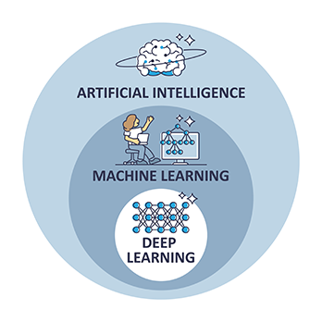
Where id Deep Learning in AI?

Slide 6
Introduction to Deep Learning
Depth Matters: Deep learning networks are characterized by their depth, meaning they have many hidden layers between the input and output layers.
This depth allows them to learn complex patterns and representations from data.

Slide 7
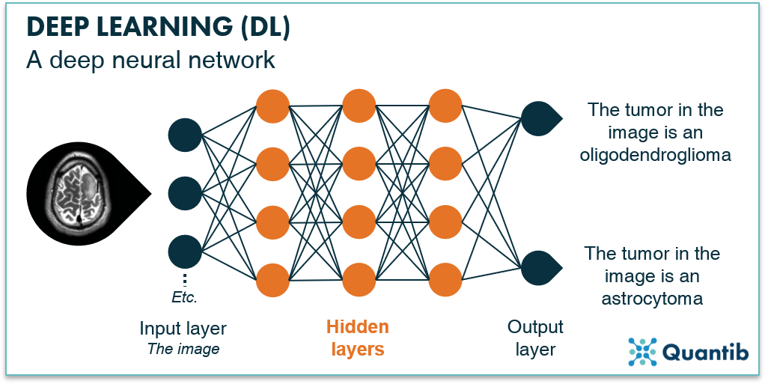
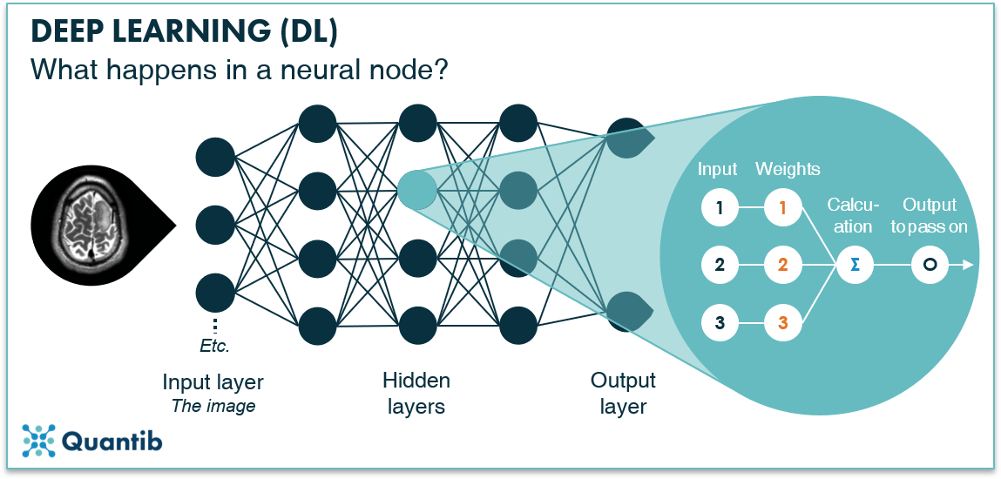
(Deep) Neural Networks
Figure 1: A deep neural network consists of an input layer, multiple hidden layers and an output layer, all consisting of nodes.
Source: https://www.quantib.com/blog/how-does-deep-learning-work-in-radiology

Slide 8
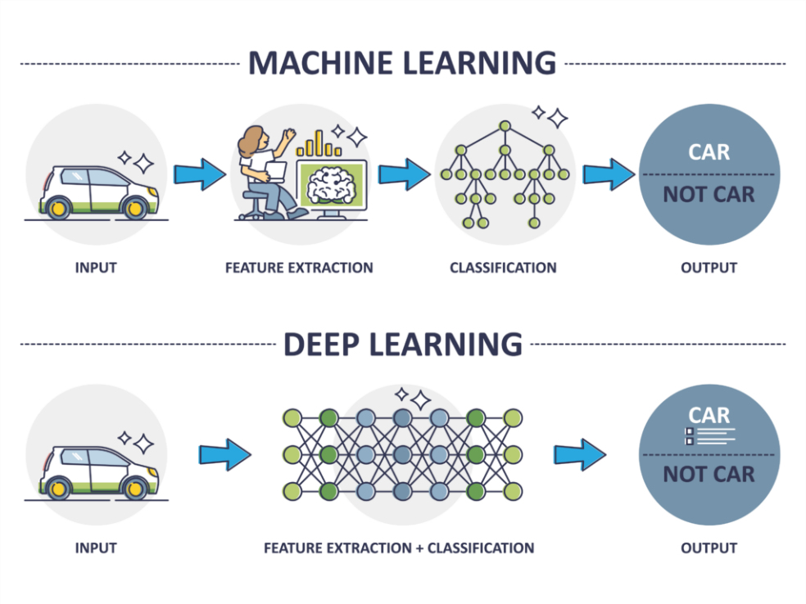
Deep Learning vs. Classical Machine Learning
Traditional Machine Learning: In classical machine learning, algorithms such as Support Vector Machines (SVM), Decision Trees, and Naive Bayes are commonly used.
These algorithms require manual feature engineering, where domain expertise is needed to extract relevant features from raw data.
Source: https://www.ait.de/en/deep-learning/

Slide 9
Deep Learning vs. Classical Machine Learning
Key Differences: Deep learning differs from classical machine learning in several ways. One crucial distinction is that deep learning models can automatically learn features from the raw data, reducing the need for manual feature engineering.
Additionally, deep learning models often have a higher capacity to capture complex patterns and relationships in data.

Slide 10
Deep Learning vs. Classical Machine Learning
Deep Learning's Edge: Deep learning excels in tasks that involve unstructured data, such as images, text, and audio.
It has achieved remarkable success in image recognition, natural language processing, and speech recognition, among others.

Slide 11
Deep Learning vs. Classical Machine Learning
Challenges: While deep learning offers many advantages, it also comes with challenges. Deep neural networks typically require a large amount of labeled data to train effectively.
Additionally, training deep models can be computationally intensive and may require specialized hardware like GPUs or TPUs.

Slide 12
Deep Learning vs. Classical Machine Learning
When to Choose Deep Learning: Deciding when to choose deep learning over classical machine learning depends on the nature of the problem.
Deep learning is well-suited for tasks where data is abundant, and complex patterns need to be extracted.
However, for simpler problems with limited data, traditional ML methods might be more appropriate.

Slide 13
AutoKeras
View documentation at: https://autokeras.com

Slide 14
What is AutoKeras?
Definition of AutoKeras: AutoKeras is an open-source AutoML library that simplifies the machine learning process by automating model selection, hyperparameter tuning, and architecture search.
Explanation of Automated Machine Learning (AutoML): AutoML refers to the automation of the end-to-end process of applying machine learning to real-world problems.

Slide 15
Why AutoKeras?
Challenges in traditional machine learning: Manual model selection and hyperparameter tuning can be time-consuming and error-prone.
Advantages of AutoKeras:
Automation of model selection: AutoKeras automatically selects the best model architecture for the given task.
Simplified hyperparameter tuning: AutoKeras automates the process of finding optimal hyperparameters.
Faster prototyping: It accelerates the development of machine learning models.
User-friendly interface: It provides an easy-to-use API for both beginners and experts.

Slide 16
Key Features of AutoKeras
Automation: AutoKeras automates many aspects of ML model building.
Simplicity: It provides a user-friendly interface.
Flexibility: Customization options are available.
Scalability: It can handle various data types and problem sizes.

Slide 17
How AutoKeras Differs from Classical ML
Manual vs. Automated: Comparing manual ML model building to AutoKeras.
Complexity Reduction: AutoKeras simplifies model selection and hyperparameter tuning.
Speed and Efficiency: Faster prototyping with AutoKeras.
Ease of Use: The user-friendly interface makes it accessible to all.

Slide 18
Installation
How to install AutoKeras: Use pip to install AutoKeras with the command pip install autokeras.
Dependencies and prerequisites: AutoKeras requires Python, TensorFlow, and other common machine learning libraries.

Slide 19
Basic Functionalities
Overview of AutoKeras's basic functionalities: AutoKeras simplifies the machine learning pipeline by offering data preprocessing, model architecture search, and hyperparameter tuning within a unified framework.

Slide 20
Data Preprocessing
Data preprocessing in AutoKeras: AutoKeras provides tools for handling missing data, data augmentation, and standardization.

Slide 21
Model Architecture Search
How AutoKeras automates model architecture search: It uses Neural Architecture Search (NAS) to discover the optimal neural network architecture for a given task.

Slide 22
Hyperparameter Tuning
Introduction to hyperparameter tuning with AutoKeras: AutoKeras uses techniques like Bayesian Optimization, Random Search, and Grid Search to optimize hyperparameters.

Slide 23
import autokeras as ak
text_classifier = ak.TextClassifier(max_trials=10)
text_classifier.fit(X_train, y_train, epochs=10)

Slide 24
Installation
Install using this command from anaconda command prombt:
pip install autokeras
Check the version of your AutoKeras:
python -c "import autokeras as ak; print(ak.__version__)"

Slide 25
Model Building with AutoKeras
# Model creation example
structured_model = ak.StructuredDataClassifier(max_trials=10)
structured_model.fit(X_train, y_train, epochs=10)
text_model = ak.TextClassifier(max_trials=10)
text_model.fit(X_train_text, y_train, epochs=10)

Slide 26
Model Evaluation
# Model evaluation example
y_pred = structured_model.predict(X_test)
accuracy = accuracy_score(y_test, y_pred)

Slide 27
Role of AutoKeras in Deep Learning
AutoKeras: AutoKeras is an open-source AutoML (Automated Machine Learning) library that simplifies the process of building deep learning models.
It automates tasks like model selection, hyperparameter tuning, and architecture search.

Slide 28
Role of AutoKeras in Deep Learning
Automation: AutoKeras significantly reduces the manual effort required in designing and fine-tuning deep learning models.
It allows users to focus on defining the problem and providing the data, while it handles the rest.
Accessibility: AutoKeras provides a user-friendly interface that makes deep learning accessible to a broader audience, including those without deep expertise in machine learning.

Slide 29
Role of AutoKeras in Deep Learning
Customization: AutoKeras also caters to advanced users who want to customize their deep learning models.
It allows users to define their search spaces for model architectures and hyperparameters, providing flexibility for experts.

Slide 30
Role of AutoKeras in Deep Learning
Neural Architecture Search (NAS): AutoKeras employs Neural Architecture Search (NAS) techniques to automatically discover optimal neural network architectures for specific tasks.
This process eliminates the need for manual architecture design and selection.

Slide 31
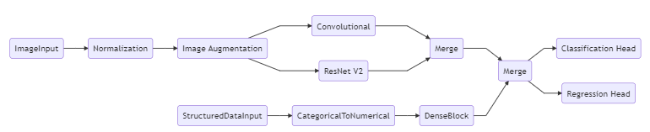
Structure of a model in AutoKeras. You basically can build those boxes by importing pre-designed and coded libraries

